Slide 1
Morbidity and Mortality
March 31st^{th}, 2025
Dan Yoakum, MD

Slide 2
Objectives
Examine ways to enhance preoperative evaluation, communication, and readiness to improve surgical outcomes.
Learn about the potential risks and complications (e.g., testicular removal) associated with delayed intervention in cases of inguinal hernias.
Identify system-level gaps that may contribute to missed diagnoses in pediatric care, with a focus on improving communication and referral pathways.
Explore strategies to improve interdisciplinary collaboration between primary care providers, specialists, and caregivers.

Slide 3
Case Presentation

Slide 4
22-day old male presents to the emergency department with decreased feeding, decreased stools, non-bilious emesis, and abdominal distension
Case

Slide 5
Case
Birth history
  37 wga born to a 20-year-old, G1P1 SVD complicated by FGR and gestational DM
Growth history
  Birth weight: 2390g (7/26/2024)
  Newborn visit 2200g (DOL 5)
  Weight check #1: 2280g (DOL 7)
  Weight check #2: 2620g (DOL 14)
  Weight on admission: 2700g (DOL 22)
Feeding history
  Breastfeeding ad lib
  Office visit #1: Vomiting; pepcid started; normal abdominal exam (DOL 19)
  Office visit #2: Abdominal ultrasound ordered; 130g weight loss (DOL 20)
  Ultrasound abdomen: No hypertrophic pyloric stenosis (DOL 21)

Slide 6
Case
ED Course (DOL 21)
  Arrival to emergency department: Triage for vomiting (18:16)
    HR 154, RR 36, Temp 37.7C; No abdominal exam documented (19:20)
  ED Provider Note: Abdominal distension noted on exam; No genitourinary exam documented (20:15)
    HR 158, BP 90/49, RR 46, Temp 36.6C
    KUB → Gaseous distention throughout length of small bowel with prominent stool in large bowel and no convincing gas in the rectum (19:35 → read at 20:08)
    CBC → Wbc 15, Hgb 15.8, Plt 408
    BMP → Na 133, K 6.6, Cl 104, Bicarb 23.6, BUN 15, Cr 0.15
    CRP → 0.4
    IStat → 7.51 / 20.5 / 16.7 / -6
    Call to Pediatric Hospitalist constipation vs obstruction (22:36)

Slide 7
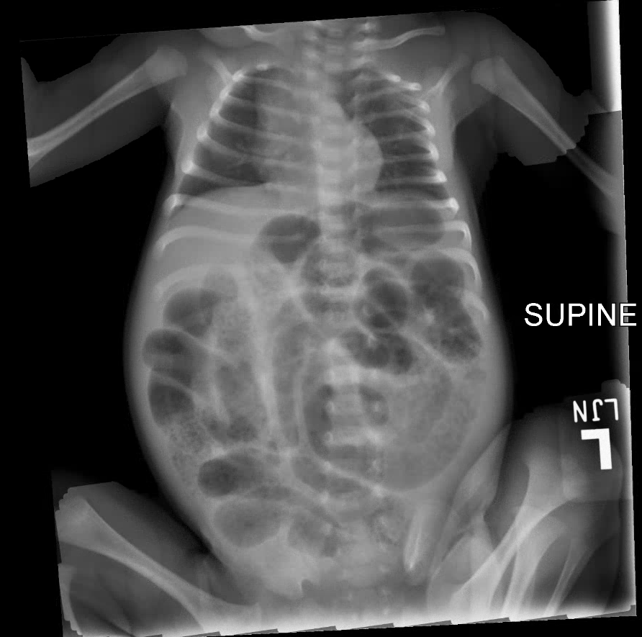

Slide 8
Case
Initial hospital course:
  Vitals: HR 170, BP 120/58, RR 44, Temp 37.1C, SpO2 100% → 00:48
  Admission orders → 00:58
  Initial reduction attempt → 01:30
  Pediatric surgery consultation and testicular doppler ultrasound order → 01:57
  Ultrasound completion → 02:30
  Pediatric surgery attempt at reduction → 02:40
  Formal testicular doppler ultrasound interpretation → 03:39
  OR time → 04:14 – 07:15

Slide 9
Case
Operative course:
  This child had a history consistent with right inguinal hernia and possible left, with the right becoming incarcerated. Pre-op ultrasound was performed showing no blood flow to right testicle. Patient taken emergently to operating room.
  Description of procedure: There was a hernia present on the right, but not on the left. The right internal ring was visualized and attempted to mobilize the intestine from the hernia sac. While doing this, a perforation was noted. Converted to exploratory laparotomy via right lower quadrant incision. The intestine was mobilized with some difficulty and brought up into the wound. The intestine was divided and anastomosed. The intestine was returned to the abdominal cavity after repairing the right inguinal hernia. Next, a transverse scrotal incision was created on the right hemiscrotum and the testicle was delivered into the wound. The testicle was clearly not viable at this point, so was excised and passed off. The scrotum was closed in layers. There was no tension and excellent hemostasis.

Slide 10
Case
Subsequent Hospital course:
  Admitted to PICU while intubated in immediate post-operative period
  Provided bowel rest and remained NPO with repogle to low intermittent suction
  Feeds gradually advanced and tolerated
  Superficial wound dehiscence with low grade fever on POD 4 and provided course of antibiotics
  Discharged on POD 10 (hospital day 11)

Slide 11
Literature Review

Slide 12

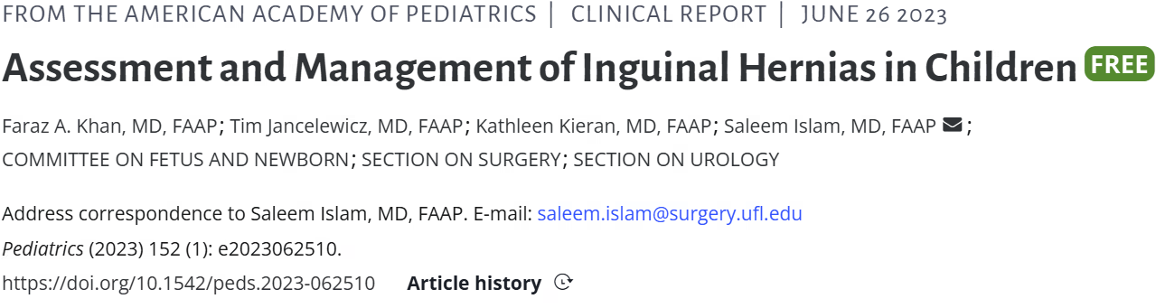
Time of Testicular Torsion | Consequence
4-6 hours | Spermatogenesis Compromise
24 hours | Universal loss of testis

Slide 13
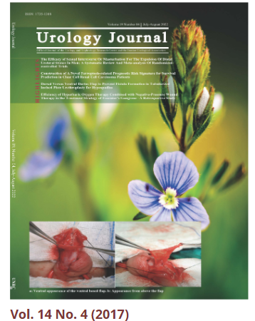
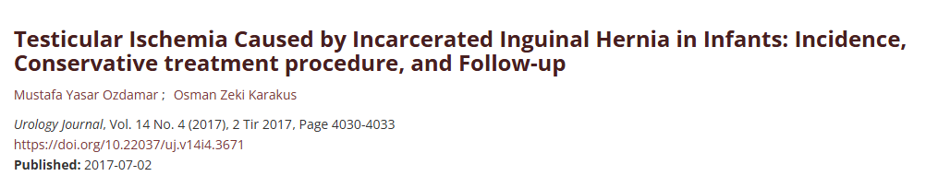
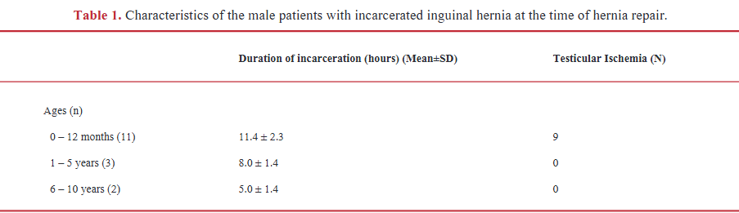
Notes:
Retrospective cohort in Turkey from 2017 consisting of about 800 inguinal hernia’s that were treated; 44 were incarcerated → Of that sample, 28 were manually reduced, 16 required surgical reduction, 9 of these patients had evidence of testicular necrosis with (avg age of 3.7 months +/- 1.3 months).
No orchiectomy performed during initial inguinal hernia repair but followed with serial dopplers and eventually resected
Not included in this table are the location or age of patients in the Test ischemia group → 7/9 right sided; mean age 3.7 mo +/- 1.3
So what does this tell me? Babies with inguinal hernia’s on the right side may be at risk for testicular ischemia if not detected and reduced at least within a day

Slide 14
Discussion

Slide 15
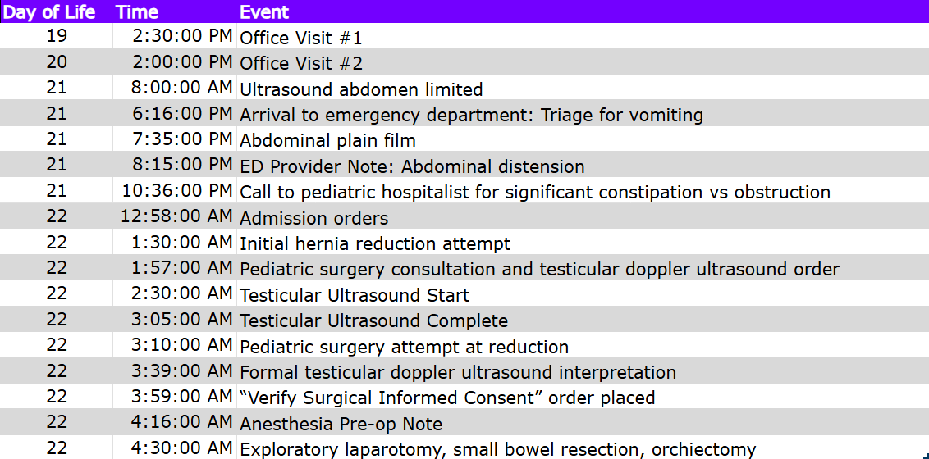
Timeline Summary

Slide 16
Areas for Improvement

Slide 17
Safety Analysis

Slide 18
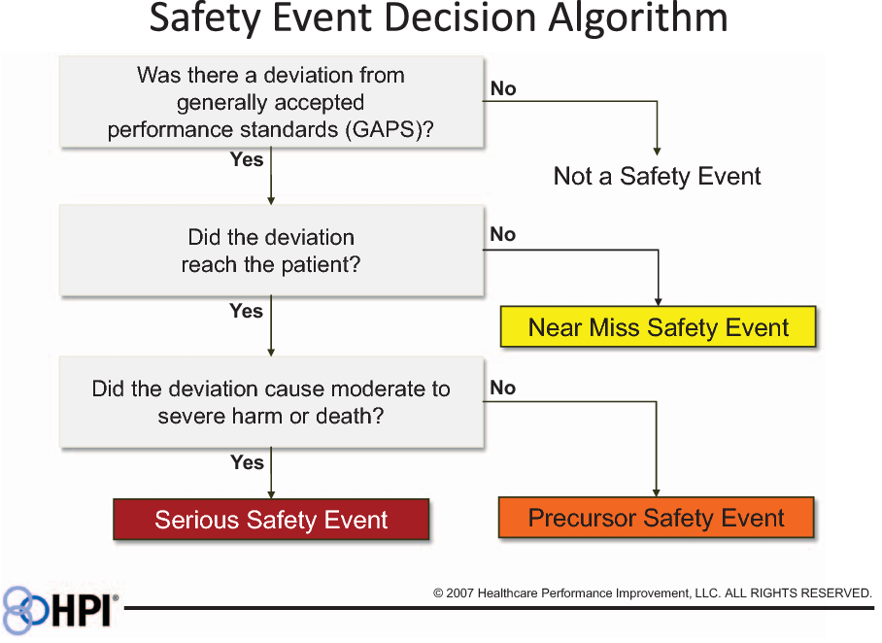
Notes:
Loss of testicle

Slide 19
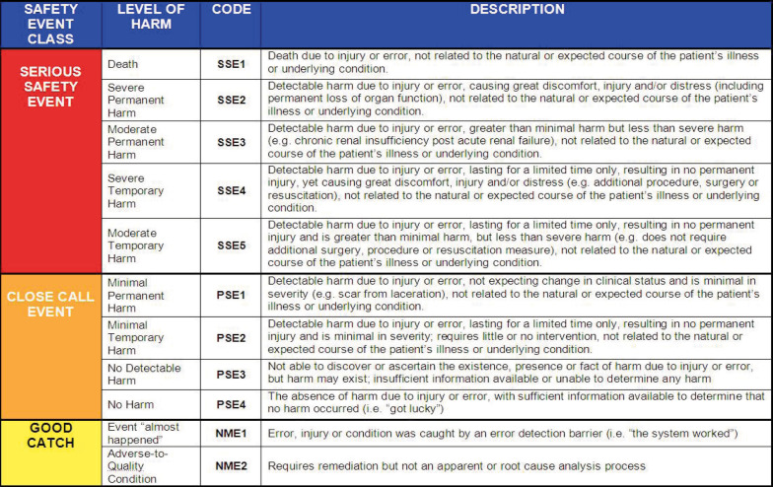

Slide 20
Time of Testicular Torsion | Consequence
4-6 hours | Spermatogenesis Compromise
24 hours | Universal loss of testis

Slide 21
References
Faraz A. Khan, Tim Jancelewicz, Kathleen Kieran, Saleem Islam, COMMITTEE ON FETUS AND NEWBORN, SECTION ON SURGERY, SECTION ON UROLOGY; Assessment and Management of Inguinal Hernias in Children. Pediatrics July 2023; 152 (1): e2023062510. 10.1542/peds.2023-062510
Ozdamar, M. Y., & Karakus, O. Z. (2017). Testicular Ischemia Caused by Incarcerated Inguinal Hernia in Infants: Incidence, Conservative treatment procedure, and Follow-up. Urology journal, 14(4), 4030–4033.

Slide 22

Thank you

